Slide 1
5 – Reading Real Data
finally, the good stuff
Notes:
“Reading” data is a little bit of jargon. To read in data just means to import

Slide 2

it’s data time
motha
forking
data

Slide 3

Packages
A package is a collection of new functions (commands)
Once we’ve installed it, we need to “load” the package from our library
Install the package once per computer
Load the package every time we open script
We’ll use a package from the tidyverse to import data smoothly
dplyr
patchwork
riverdist
vegan
lubridate
ggplot2
mgcv
scales
here
Library Metaphor:
Put a book on your shelf:
install.packages()
Pull book from your shelf to use it:
library()

Slide 4
But First! Some computer review
Spending time at the outset thinking about folder structure and data setup will save you LOTS of time later on. So we’ll review:
Folder structure – Where IS it?
Data Organization – Is it clear?
“Tidying” Up – What is Tidy Data?
Computer Review!

Slide 5
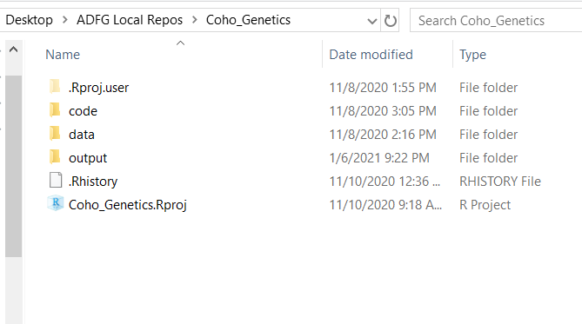
Folder Structure
It is very helpful to standardize your structure
Under your main project folder, use one .Rproj for that group of analyses. Use folders named:
data
code (or “analysis”)
output
etc.

Slide 6

Folders (Directories)
What is a directory?
Using modern tools in R (like RProjects!) avoids many of the headaches with directories; regardless, it’s important to be aware of these issues.
Before importing your data, you should know where R thinks you are
somewhere on
your computer

Slide 7
Where AM I?! (Directory Location)
Use getwd() to see what folder R is currently set to
Type file.choose() to see the exact location of a file
Click the file you’d like, it will print file location to the console
When using RProjects, we can use relative file paths:
Where am I?
Full file path: C:/Users/jtpriest/ADFG_R_Intro_Workshop/code/2_First_script.R
Relative file path: code/2_First_script.R

Slide 8
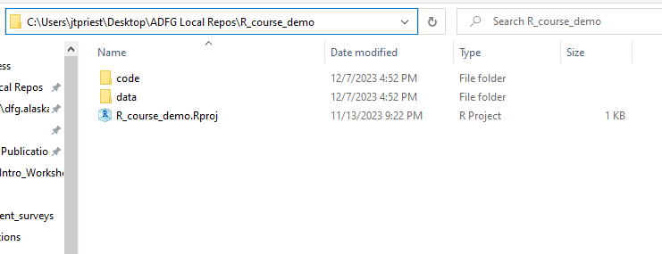
Folders & RProjects
RProjects set your directory to the location of where the .Rproj file is located. This is VERY useful!
If you have a file in folder data like to the right, what happens if you write:
read_csv(“input.csv”)
It can’t find the file. Change this to
read_csv(“data/input.csv”)
This would also work:
read_csv(“C:/Users/jtpriest/Desktop/ADFG Local Repos/R_course_demo/data/input.csv”)

Slide 9




Data
Data should be:
Machine Readable – easily imported
Unsummarized & Raw – try not to edit it before importing into R
Untabled – Use “long” format (lots of rows) e.g., each row being a year & species
Tidy – Each column is a variable; each row an observation; every cell a single value

Slide 10
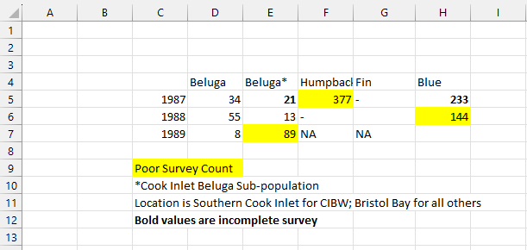
“Machine Readable”
Important data import point! We will be importing data to a machine, so think like one. What are some problems with importing this data?

Slide 11
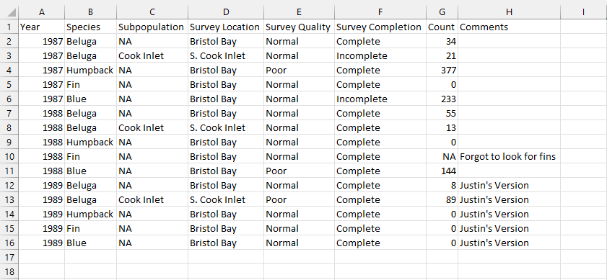
Machine Readable
Don’t use color/formatting; have columns for variables; don’t have hidden data; be consistent about blanks vs NA vs 0; start at cell A1

Slide 12
Unsummarized and untabled
River | Length
Kenai | 560
Kenai | 610
Kenai | 575
Taku | 565
Taku | 585
Data that are already summarized can’t have stats. Raw is best!
“Tabled” data is a form of summarizing and isn’t tidy (more on this in a second!)
River | Count | Ave Len
Kenai | 3 | 581.6
Taku | 2 | 575
Year | Species | Count
2022 | Coho | 3
2022 | King | 5
2023 | Coho | 8
2023 | King | 11
 | Coho | King
2022 | 3 | 5
2023 | 8 | 11

Slide 13
Tidy vs non-tidy data
Which of these datasets are tidy data?
Year | River | Count
2018 | Auke Creek | 619
2019 | Auke Creek | 1235
2020 | Auke Creek | 634
2018 | Berners River | 3550
2019 | Berners River | 9405
2020 | Berners River | 3296
2018 | Hugh Smith | 619
2019 | Hugh Smith | 1235
2020 | Hugh Smith | 634
Year | Auke Creek | Berners River | Hugh Smith Lake
2018 | 146 | 3550 | 619
2019 | 345 | 9405 | 1235
2020 | 173 | 3296 | 634
This one!
Any guesses why?

Slide 14
Tidy vs non-tidy data
To see why: if there were a comment, which does it refer to?
Year | River | Count | Comment
2018 | Auke Creek | 619 | No fish 7/24-8/25
2019 | Auke Creek | 1235 | Kayla quit counting
2020 | Auke Creek | 634 | High water 8/30
2018 | Berners River | 3550
2019 | Berners River | 9405
2020 | Berners River | 3296 | Not a peak count
2018 | Hugh Smith | 619
2019 | Hugh Smith | 1235 | Prob 100 fish low
2020 | Hugh Smith | 634 | Kayla didn’t count jacks
Year | Auke Creek | Berners River | Hugh Smith Lake | Comment
2018 | 146 | 3550 | 619 | No fish 7/24-8/25
2019 | 345 | 9405 | 1235 | Kayla quit counting
2020 | 173 | 3296 | 634 | Prob 100 fish low
Notes:
Why isn’t this tidy? If the last column were for “comments”, which observation would the comment refer to?

Slide 15
Tidy Data
year | river | species | count
2007 | Kenai | burbot | 5
2007 | Susitna | burbot | 9
2007 | Susitna | sucker | 3
2008 | Kenai | burbot | 6
2008 | Susitna | burbot | 8
2008 | Susitna | sucker | 3
year | river | species | count
2007 | Kenai | burbot | 5
2007 | Susitna | burbot | 9
2007 | Susitna | sucker | 3
2008 | Kenai | burbot | 6
2008 | Susitna | burbot | 8
2008 | Susitna | sucker | 3
year | river | species | count
2007 | Kenai | burbot | 5
2007 | Susitna | burbot | 9
2007 | Susitna | sucker | 3
2008 | Kenai | burbot | 6
2008 | Susitna | burbot | 8
2008 | Susitna | sucker | 3
Each column is a variable
Each row is an observation
Each cell is a value

Slide 16

Why be Tidy?
Though Excel is quick, it can give us bad habits
By using tidy data, we can:
Add comments to each observation
Easily pair a variable to new data
Ensure all observations are of same type & structure
This WILL save you time later
Who cares?!

Slide 17
Data Do’s & Data Don’ts
Use unsummarized data (if possible)
To the extent possible, do cleanup in R so that if you re-download from your database (e.g., OceanAK) you don’t have to spend time changing things
Starting out, you can “cheat” and clean up in Excel first
It is highly recommended to bite the bullet and do all of this in R!
Don’t use “tabled” data, e.g., Year by Stream
Use “long” format with many rows where each row is a year and a stream
Use “tidy” data where:
- Every column is variable. - Every row is an observation. - Every cell is a single value.
More info here
Notes:
Before getting your data in, you will need to make sure that it is “machine readable”
Using R and the tidyverse will make you better with your data. While Excel is great for many things, especially quickness, it allows for bad habits. For example, it will let you combine different types of data into the same column (a column for “Length” can include 100, TRUE, “No sample here”; this is a massive data issue).

Slide 18
Quiz 5-1
What is a directory?
a) A phone book
b) Another word for folder
c) The computer’s file locations
d) A place to store directors
What is tidy data?
a) All columns are variables
b) One row, one observation
c) Tabled data
QUIZ!

Slide 19

Quiz 5-1
What is a directory?
a) A phone book
b) Another word for folder
c) The computer’s file locations
d) A place to store directors
What is tidy data?
a) All columns are variables
b) One row, one observation
c) Tabled data
QUIZ!

Slide 20
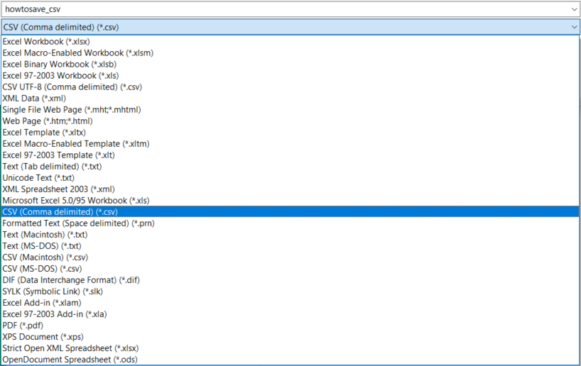

FINALLY! Getting data into R!
Import things as a .CSV if you can
This prevents issues by using a static file (i.e., no formulas)
(All databases allow export as .CSV)
You can import files in .XLS or .XLSX but it’s easier to use “flat” files
Use “read_csv()” from the package “tidyverse”
You may also see code online for read.csv()
X

Slide 21

Reading in a file
Getting data into R is relatively simple! Use:
read_csv(“folderlocation/filename.csv”)
read_csv(“folderlocation\\filename.csv”)
NOT read_csv(“folderlocation\filename.csv”)
You must use a forward slash “/” or 2 back slashes “\\” to designate a folder or directory
This is different than the way Windows shows

Slide 22

Reading in a file
Can I use the RStudio Import Wizard?
No.
Future you (or colleagues) will not know which file you chose.
Notes:
Can anyone tell me why this would be a bad idea?

Slide 23
SHOW ME THE DATA
OK so you have your data in. How can we look at it?
Type the name in console (shows first few rows/columns)
Type View(dataframe_name) or click on the dataframe name in the top right pane (shows same thing).
Once opened, you can now filter, sort, scroll, etc.
Check structure: str(dataframe_name)
summary(dataframe_name) to see info about dataframe

Slide 24
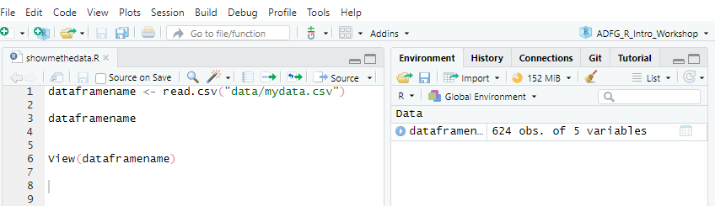

SHOW ME THE DATA IN RSTUDIO
Run line 3 (show first part of data) Run line 6 (show all rows)
Click here to show all rows, same as View()

Slide 25


Data Import
Simply importing the data is the easy part
What takes time is being thorough, so your data is:
Clean, tidy data;
Clearly named
Correct column “type”
Excuse me,
do you have a moment to speak about programming?
Notes:
OK that’s it! We had an entire section just around one single function!

Slide 26
Data Import
Analysis Checklist
Data is:
QA/QC’d
Flat file (.csv, etc.)
Not summarized
One row/observation
Make a new directory (folder) & RProject

Slide 27
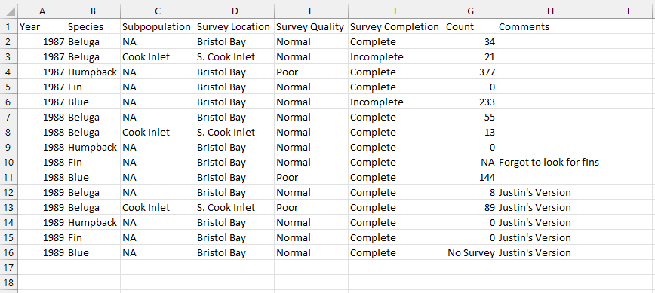
The most common data error
What is the problem here:
What does this do to this entire column??

Slide 28
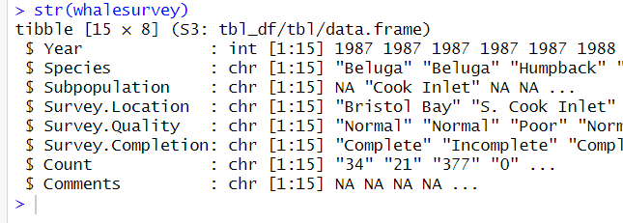
The most common data error
Always carefully check the structure of your data after importing
It is very common for words (text) to appear in a column of numbers
This makes the whole column of type “character”
str() shows type

Slide 29
Quiz 5-2
Which of these correctly reads a file “mydata.csv” from folder “data” into R?
a) readcsv(“data/mydata.csv”)
b) read_csv(“data/mydata.csv”)
c) read(“data/mydata.csv”)
d) read_csv(“data\mydata.csv”)
What are some ways we can see the data in RStudio after import?
a) Click dataframe name in top right pane “Environment”
b) View(dataframename)
c) Type dataframename into console
QUIZ!

Slide 30
Quiz 5-2
Which of these correctly reads a file “mydata.csv” from folder “data” into R?
a) readcsv(“data/mydata.csv”)
b) read_csv(“data/mydata.csv”)
c) read(“data/mydata.csv”)
d) read_csv(“data\mydata.csv”)
What are some ways we can see the data in RStudio after import?
a) Click dataframe name in top right pane “Environment”
b) View(dataframename)
c) Type dataframename into console
QUIZ!

Slide 31
Quiz 5-2 - BONUS
Which of these correctly reads a file “mydata.csv” from folder “data” into R?
a) readcsv(“data/mydata.csv”)
b) read_csv(“data/mydata.csv”)
c) read(“data/mydata.csv”)
d) read_csv(“data\mydata.csv”)
What are some ways we can see the data in RStudio after import?
a) Click dataframe name in top right pane “Environment”
b) View(dataframename)
c) Type dataframename into console
QUIZ!
Why did each of these fail??? Let’s discuss

Slide 32



Error Are Puzzles not Problems
Importing data into R often brings errors or unexpected issues.
Let’s chat about errors and reframe them as puzzles
Every error has a message and there are clues in it!

Slide 33
Errors – Don’t Fret!
It is VERY normal to get errors every other line starting out
DO NOT WORRY
Error messages are just a clue to get your code closer to running
Don’t Worry
Be Happy

Slide 34

Some Common Errors
Misspelling variable/function
Not ending a line in parenthesis, comma, etc.
Unpaired parentheses/quotes
Capitalizing vs no caps
Not loading package before calling function
Wrong data type is used
RStudio will help minimize these!
Experience, going slow & thorough minimizes these!

Slide 35

Error Clues – Let’s solve together
Error: Solution:
unexpected symbol / constant
> summary(c(1, 2, 4) digits = 2) Error: unexpected symbol in "summary(c(1, 2, 4) digits"
Check for commas, parentheses
> mean(c(1,2 4))
Error: unexpected numeric constant in "mean(c(1,2 4"
could not find function
Review spelling;
Need to load package
> red.csv("data/thedudeabides.csv") Error in red.csv("data/thedudeabides.csv") : could not find function "red.csv"
No such file or directory
> read.csv("data/thedudeabides.csv") Error in file(file, "rt") : cannot open the connection In addition: Warning message: In file(file, "rt") : cannot open file 'data/thedudeabides.csv': No such file or directory
Filename misspelled or folder misnamed

Slide 36

Embrace the Error
Errors don’t go away, you just get faster at solving them

Slide 37
Quiz 5-3
BUG HUNTER: Each of these lines of code give an error. Find the error!
a) readcsv(“data/mydata.csv”)
b) mean(c(1, 2 3))
c) Summary(c(1, 2, 3))
d) mean(c(1, 2, 3 ,4)))
Errors are:
a) A massive problem
b) Puzzles to solve
c) Frequent
Clues containing hints
Common for all coders
QUIZ!

Slide 38
Quiz 5-3
BUG HUNTER: Each of these lines of code give an error. Find the error!
a) read.csv(“data/mydata.csv”)
b) mean(c(1, 2, 3))
c) summary(c(1, 2, 3))
d) mean(c(1, 2, 3 ,4)))
Errors are:
a) A massive problem
b) Puzzles to solve
c) Frequent
Clues containing hints
Common for all coders
QUIZ!

Slide 39
Resources

Slide 40
Tell R where to go! (SET Directory Location)
Use setwd() to set your directory to different than default
Not needed when using Rprojects!

Slide 41
Error Summary Table – Reference
Error Message | Possible Problem
unexpected symbol in ____ | You made a syntax (coding grammar) error (extra comma, parenthesis, etc.)
could not find function | You forgot to load a package or misspelled the function name.
cannot open file .* : No such file or directory | You tried a path that doesn't exist.
there is no package called ___ | You forgot to install a package or misspelled the package name
object .* not found | The object you are looking for might not exist.
non-numeric argument to ___ | You tried to use a character vector where a numeric is needed.
attempt to apply non-function | You tried to use an object which is not a function as a function.
object of type 'closure' is not subsettable | You called `$` on a function.
More common
Less common
Based on https://github.com/colinfay/argh
Notes:
Don’t memorize this list! Instead use it as a reference to come back to.
These are somewhat organized from the error messages that you’ll see today to those that are a little more obscure

Slide 42


Data Review
Yay! You’re almost ready to import data!
A couple of items to note about your data to save time in the long run:
Data DO! | Data DON’T
Use raw data (straight from database if possible) | Don’t summarize data before importing
Use “tidy” data | Don’t use data that is “tabled”
DB
Notes:
Before getting your data in, you will need to make sure that it is “machine readable”
Using R and the tidyverse will make you better with your data. While Excel is great for many things, especially quickness, it allows for bad habits. For example, it will let you combine different types of data into the same column (a column for “Length” can include 100, TRUE, “No sample here”; this is a massive data issue).

